Slide 1
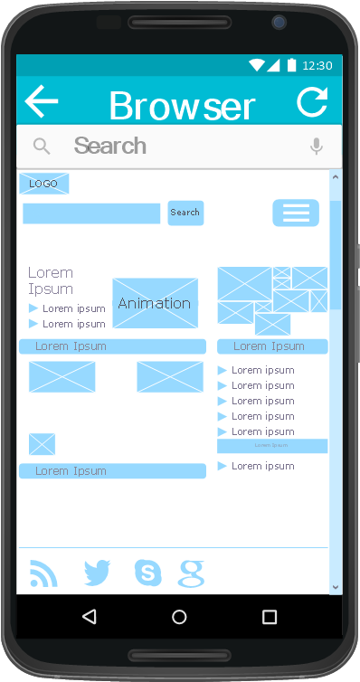
Research Question:
Is Xamarin (or other hybrids) cross-platform development cost effective & viable for mobile development in start-ups vs. native or web mobile development?

Slide 2
Key Words for scope of report:
Good for search engines
Xamarin (Hybrid)
Cross-platform development
Cost
Mobile development
Start-ups
Native
Web mobile development

Slide 3
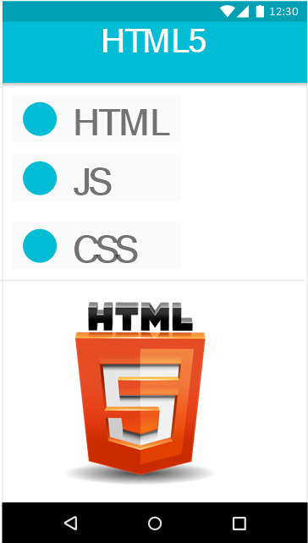
Web / HTML5 App Development
Main Point:
Develop once and you can deploy your code across all of the major platforms.
Advantages | Disadvantages
Easy to build (HTML/CSS/JS) Easy to maintain Use any technology/language Cheaper than native and hybrid apps Single app for all platforms | Need to run in browser (poor user experience) Slower than native apps Less interactive and less intuitive No icon in desktop Cannot be submitted to app store Cannot interact with device utilities
Notes:
3

Slide 4
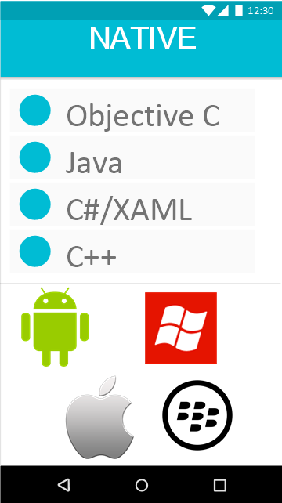
Native App Development
Main point:
For native development you have to use objective-c for iPhone,
Java for Android, and ETC, this means that you need to
recreate your app each and every time for each platform
redo the whole thing again and again for each of these platforms.
Advantages | Disadvantages
Very fast Built to run on specific platform Distributed in app store Interactive & intuitive Interact with device utilities Full access to device’s APIs | Single platform Harder languages? Very expensive Hard to maintain

Slide 5
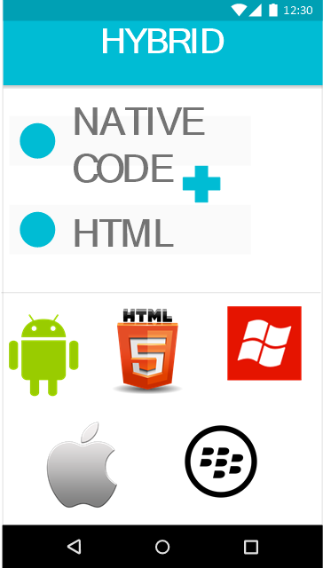
Hybrid App Development
Main point:
Hybrid approach you develop part of your app using html5
and part of your app using native code. How much native and HTML are up to you, but you can combine these technologies and developed your mobile app using a combination of HTML and native code. Single development for all platforms.
Advantages | Disadvantages
Easy to build – HTML/CSS/JavaScript Much cheaper the native app Single app for all platforms (PhoneGap) No browse needed Can usually access device utilities using API Faster to develop than native apps | Slower than native apps More expensive than web apps Less interactive than native apps (getting better every day)

Slide 6
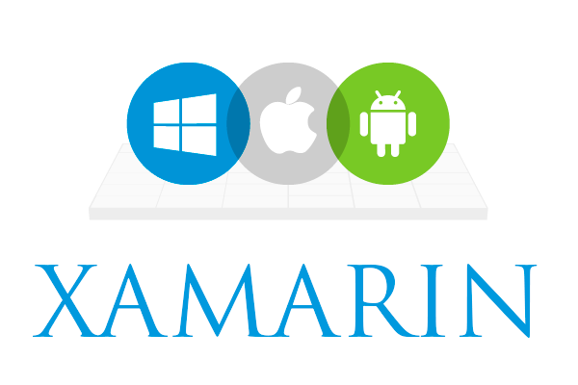
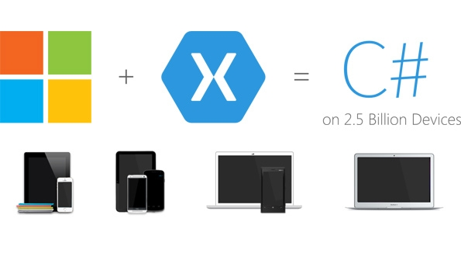
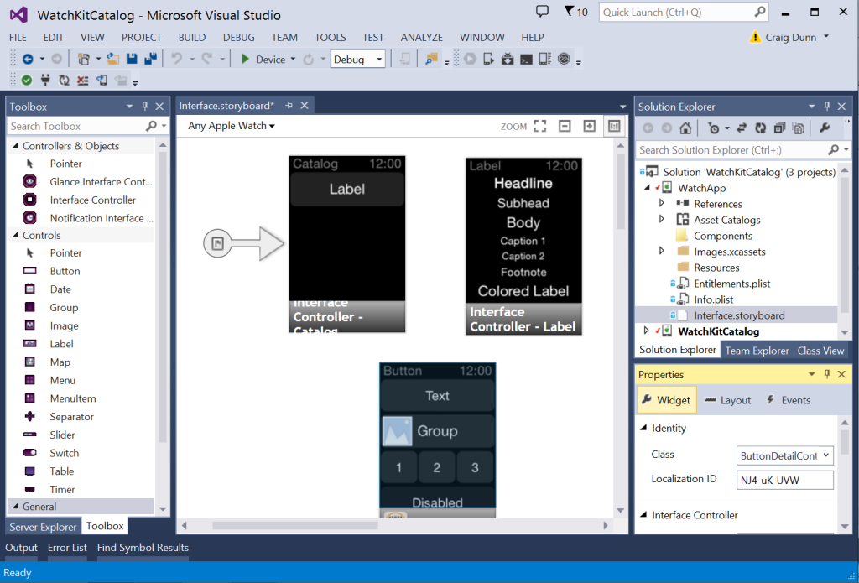
What is Xamarin?
It’s cross platform development technology, where we can build native user interfaces for iOS, Android and Windows Phone using single codebase with C#.

Slide 7
CASE STUDY:
Paper:
A Comparative Analysis of Cross-platform Development Approaches for Mobile Applications
Researchers:
Spyros Xanthopoulos, University of Thessaloniki, Greece.
Stelios Xinogalos, University of Macedonia, Greece.
Goals:
created is a simple RSS feeds client, targeted at Android and iOS platforms.
The RSS client will query for the latest Apple’s press info news (http://www.apple.com/pr/feeds/pr.rss) and display the data on the device screen.
Problem: Self study, only participant them selves.
Software: Titanium.

Slide 8
Summary:
Is Xamarin the right choice for start-ups? Yes and no, every Literature, blog, YouTube video gives the same conclusion, depends on the application development scope, time and capital.
Native approach if you need a high performance, “user experience” and full API access.
Web approach if you require deployment on all platforms, cheap development cost and scope of app is simplistic.
Hybrid if you want the look and feel of a native app to give better “user experience”, cheaper cost then native and for Xamarin if your company already uses C#.

Slide 9
Question Time.
Question idea: give me an example of an app and ill give you what approach to use.

